Slide 1
Hypothesis Testing

Slide 2
Class Objectives
Developing Null and Alternative Hypotheses
Type I and Type II Errors- Explanation
Population Mean: Sigma Known
Population Mean: Sigma Unknown
Population Proportion

Slide 3
Hypothesis Testing
Hypothesis testing can be used to determine whether a statement about the value of a population parameter should or should not be rejected.
The null hypothesis, denoted by H₀ , is a tentative assumption about a population parameter
The alternative hypothesis, denoted by Ha, is the opposite of what is stated in the null hypothesis
The hypothesis testing procedure uses data from a sample to test the two competing statements indicated by H0 and Ha.

Slide 4
Developing Null and Alternative Hypotheses
It is not always obvious how the null and alternative hypotheses should be formulated
Care must be taken to structure the hypotheses appropriately so that the test
conclusion provides the information the researcher wants
The context of the situation is very important in determining how the hypotheses should be stated
In some cases it is easier to identify the alternative hypothesis first. In other
cases the null is easier
Correct hypothesis formulation will take practice

Slide 5
Developing Null and Alternative Hypotheses
Alternative Hypothesis as a Research Hypothesis
Example: A new manufacturing method is believed to be better than the current method.
Alternative Hypothesis:
The new manufacturing method is better.
Null Hypothesis:
The new method is no better than the old method.

Slide 6
Developing Null and Alternative Hypotheses
Alternative Hypothesis as a Research Hypothesis
Example: A new bonus plan, that is developed in an attempt to increase sales
Alternative Hypothesis:
The new bonus plan increase sales
Null Hypothesis:
The new bonus plan does not increase sales

Slide 7
Developing Null and Alternative Hypotheses
Alternative Hypothesis as a Research Hypothesis
Example:
A new drug is developed with the goal of lowering Cholesterol-level more
than the existing drug
Alternative Hypothesis:
The new drug lowers Cholesterol-level more than the existing drug
Null Hypothesis:
The new drug does not lower Cholesterol-level more than the existing drug

Slide 8
Developing Null and Alternative Hypotheses
Null Hypothesis as an assumption to be challenged
We might begin with a belief or assumption that a statement about the value of a population parameter is true
We then using a hypothesis test to challenge the assumption and determine if there is statistical
evidence to conclude that the assumption is incorrect
In these situations, it is helpful to develop the null hypothesis first

Slide 9
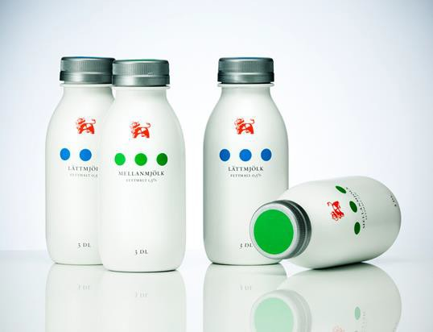
Developing Null and Alternative Hypotheses
Null Hypothesis as an Assumption to be Challenged
Example:
– The label on a milk bottle states that it contains 1000 ml
Null Hypothesis:
– The label is correct.
µ > 1000 ml
Alternative Hypothesis:
– The label is incorrect. µ < 1000 ml

Slide 10






Null and Alternative Hypotheses about a Population Mean μ
The equality part of the hypotheses always appears in the null hypothesis
In general, a hypothesis test about the value of a population mean μ must take one of the following three forms (where μ₀ is the hypothesized value of the population mean)
One-tailed
(lower-tail)
One-tailed
(upper-tail)
Two-tailed

Slide 11

Null and Alternative Hypotheses
A major hospital in Chennai provides one of the most comprehensive emergency medical services in the world
Operating in a multiple hospital system with approximately 10 mobile medical units, the service goal is to respond to medical emergencies with a mean time of 8 minutes or less
The director of medical services wants to formulate a hypothesis test that could use a sample of emergency response times to determine whether or not the service goal of 8 minutes or less is
being achieved.

Slide 12
Null and Alternative Hypotheses
The emergency service is meeting the response
goal; no follow-up action is necessary.
H₀: μ < 8
H : μ > 8
The emergency service is not meeting the response goal; appropriate follow-up action is necessary.
a
where: μ = mean response time for the population
of medical emergency requests

Slide 13
Type I Error
Because hypothesis tests are based on sample data, we must allow for the possibility of errors
A Type I error is rejecting H₀ when it is true
The probability of making a Type I error when the null hypothesis is called the level of significance
Applications of hypothesis testing that only control the Type I error are
often called significance tests

Slide 14
Type II Error
A Type II error is accepting H₀ when it is false.
It is difficult to control for the probability of making a Type II error.
Statisticians avoid the risk of making a Type II error by using “do not reject H₀” and not “accept H₀”.

Slide 15

Type I and Type II Errors
Population Condition
 | H0 True (μ < 8) | H0 False (μ > 8)
Conclusion
Accept H0 (Conclude μ < 8) | Correct Decision | Type II Error
Reject H0 (Conclude μ > 8) | Type I Error | Correct Decision

Slide 16
Three Approaches for Hypothesis Testing
P- Value
Critical Value
Confidence Interval Value

Slide 17
p-Value Approach to One-Tailed Hypothesis Testing
The p-value is the probability, computed using the test statistic, that measures the support (or lack of
support) provided by the sample for the null hypothesis
If the p-value is less than or equal to the level of significance α , the value of the test statistic is in the rejection region
Reject H₀ if the p-value < α

Slide 18
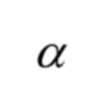






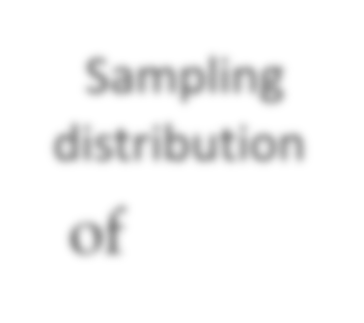

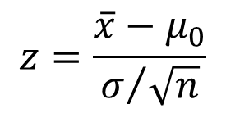
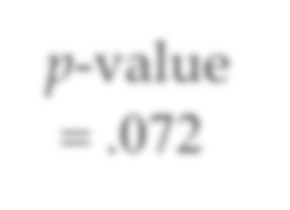



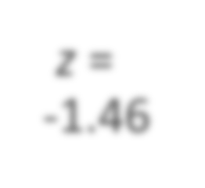
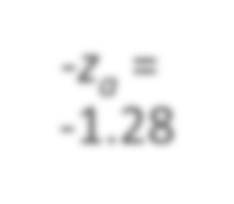

Lower-Tailed Test About a Population Mean: 0 Known
p-Value Approach
p-Value < α ,
so reject H₀.
α = .10
Sampling distribution
of
p-value
= .072
z
z = -z_{a} =
-1.46 -1.28
0

Slide 19
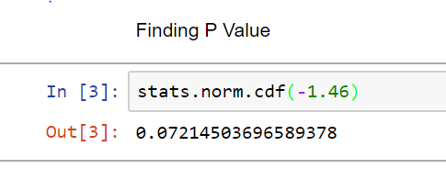
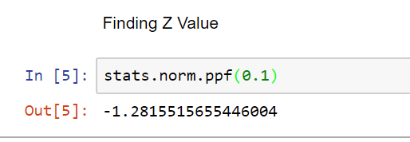
p-Value Approach

Slide 20
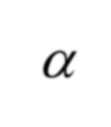





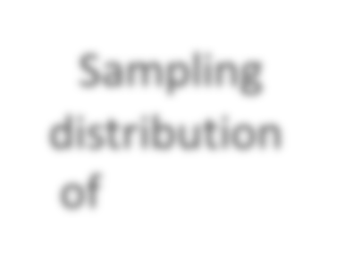
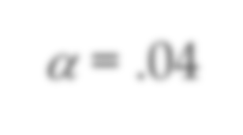

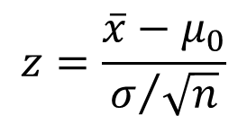
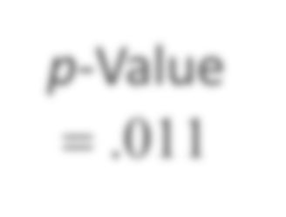





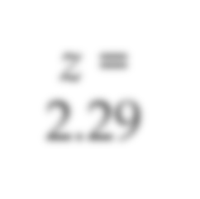
Upper-Tailed Test About a Population Mean :0 Known
p-Value Approach
p-Value < α , so reject H₀.
Sampling distribution of
α = .04
p-Value
= .011
z
0
z_{α} = z =
1.75 2.29

Slide 21
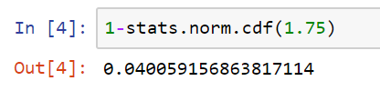

p-Value Approach

Slide 22
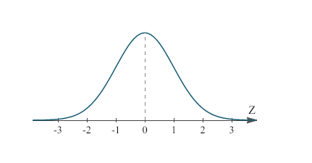
Critical Value Approach to One-Tailed Hypothesis Testing
The test statistic z has a standard
normal probability distribution.
We can use the standard normal probability distribution table to find the z-value with an area of α in the lower (or upper) tail of the distribution.
The value of the test statistic that established the boundary of the rejection region is called the critical value for the test.
The rejection rule is:
Lower tail: Reject H₀ if z < -z_{α}
Upper tail: Reject H₀ if z > z_{α}

Slide 23


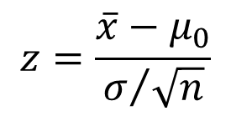









Lower-Tailed Test About a Population Mean: 0 Known
Critical Value Approach
Sampling distribution
of
Reject H₀
α = .10
Do Not Reject H₀
z
−z_{α} = −1.28
0

Slide 24
In [ 6] : st at s . norm1. p pf ( 0. 1)
Out[6 :
-1.2815515655446004

Slide 25
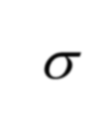

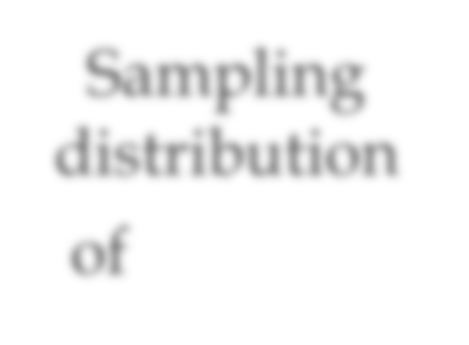











Upper-Tailed Test About a Population Mean: 0 Known
Critical Value Approach
Sampling distribution
of
Reject H₀
α = .05
Do Not Reject H₀
z
0
z_{α} = 1.645

Slide 26
Out [7]:
l. 64485.362695,14722

Slide 27
Steps of Hypothesis Testing – P value approach
Step 1. Develop the null and alternative hypotheses.
Step 2. Specify the level of significance α.
Step 3. Collect the sample data and compute the test
statistic.
p-Value Approach
Step 4. Use the value of the test statistic to compute the p-value.
Step 5. Reject H₀ if p-value < α.

Slide 28


Steps of Hypothesis Testing
Critical Value Approach
Step 4. Use the level of significance α
to determine the critical value and
the rejection rule.
Step 5. Use the value of the test statistic and the rejection rule to determine whether to reject H₀.

